Slide 1
11.3 Lesson Plan
Callbacks & Constructors in the Wild
THURSDAY (6:30 PM) 11.3 Lesson Plan

Slide 2
PreClass Challenge

Slide 3
PrecLASS CHALLENGE
ARRAY SEARCH Write a function that takes an array an element to find Without using any built in array methods,
return true if the element is in the array or false otherwise. Ex: Input: [1,2,3] 1 Output: true Input: [1,2,3] 4 Output: false Input: ['code', 'dev', 'nerd'] 'nerd' Output: true Input: ['code', 'dev', 'nerd'] 'genius' Output: false

Slide 4
PrecLASS CHALLENGE
var includes = function(arr, elem){ for (var i = 0; i < arr.length; i++){ if(elem === arr[i]){ return true; } } return false; }

Slide 5
Admin Items
jQuery $(Begins)

Slide 6
Administration… (6:30 – 6:35 PM) 5 mins)
Homework 10 Due Tonight, 7/25/19 by 11:59pm
Homework 11 (Word Guess) Due Thursday, 8/1/19 by 11:59pm
Video Guide: 11-js-constructors/VideoGuide.md
Next Week – 12-MySQL Databases
Use Tutors if you need them
When you get a SURVEY, be BRUTALLY HONEST!
Sign into BootCampSpot and mark your attendance
Any Questions from Last Time?
jQuery $(Begins)

Slide 7
Homework 11 – Word Guess
This homework assignment is **optional**. In this unit's assignment, you will create a Word
Guess command-line game using constructor functions.

Slide 8
Class Objectives
After today’s class, students will be able to:
Sketch the design of their applications before they start to code;
Use constructors to create objects; and
Explain callbacks and closures.
Take Node Checkpoint.

Slide 9
1. Instructor Do: Demonstrate Application (6:30 PM - 6:35 PM) (5 mins)
11-js-constructors/01-Activities/14-Stu_FinalTVApp
This application makes use of the TV Maze API to as a data source.
Search for TV shows using command line arguments, e.g. –
- node cli show Westworld.
Search for actors/actresses as well using command line arguments, e.g.
- node cli actor Talulah Riley.
- log.txt file.

Slide 10
1. Instructor Do: Demonstrate Application (6:30 PM - 6:35 PM) (5 mins)
Explain that we’ll proceed step-by-step. Students will:
Write out a high-level application architecture;
Implement logic for parsing command-line arguments and running the appropriate functionality in a cli.js file.
Implement the logic for searching for actors or shows using an object generated by a constructor function in a tv.js file.

Slide 11
2. Partners Do: Sketch Architecture (6:35 PM - 6:50 PM) (15 mins)
11-js-constructors/01-Activities/11-Stu_Architecture
Instructions
* As a best practice, sketch out the architecture of your application _before_ you start writing code.
* For this exercise, start by describing what your application does. Do this in a bullet list.
* Next, decide how you might divvy up these responsibilities. Would you write a single module that handles all of them? Would you write one module for each bullet list? Something else? Be sure to justify your decision.
* Finally, draw a diagram describing the flow of your application. Don't worry about being _too_ precise here, but include enough detail where you can use it as a guide to explain it to someone else. You can do this either by using pencil and paper or flowchart generation software like [draw.io](https://www.draw.io/).

Slide 12
Remind students that the application:
Accepts command-line arguments indicating whether the user intends to search for tv shows or tv actors;
Makes an API request to one of two different API endpoints; and
Saves the results of the requests to a log.txt file and prints the data to the console.

Slide 13
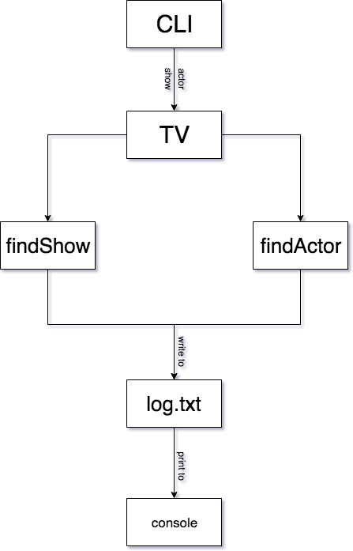

Slide 14
3. Instructor Do: Review Activity (6:50 PM - 6:55 PM) (5 mins)
Ask a group to:
Share their bullet list;
Describe the components they would define; and
Explain why they would define their modules this way.
Briefly discuss the pros and cons of their solution.
Present the README.md file in 11-Stu_Architecture/Solved, and explain that while there are many ways to write the same application, we’ve chosen this way to be consistent as we work through the activities as a class.

Slide 15
4. Partners Do: Implement CLI (6:55 PM - 7:10 PM) (15 mins)
11-js-constructors/01-Activities/12-Stu_Cli
Instructions:
When the completed cli.js file is run with node, it should be able to handle command line arguments similar to those below: node cli show The Andy Griffith Show node cli actor Andy Griffith
FORMAT:
node cli <show-or-actor> <actor-or-show-name>
Bonus:
Write logic to set up a default search type and default term if either are missing.

Slide 16
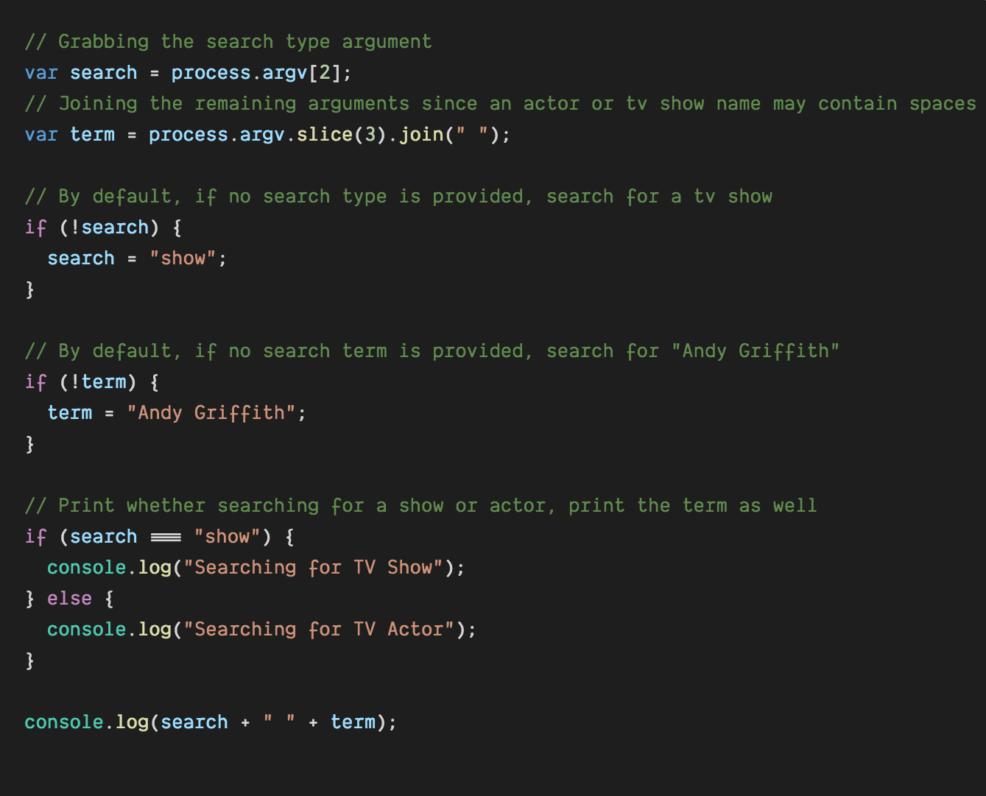
Objectives Met
Parse command line arguments to determine whether the user is searching for a show or actor, along with which one.

Slide 17
5. Instructor Do: Review Activity (7:10 PM - 7:20 PM) (10 mins)
Open up the cli.js in 12-Stu_Cli/Solved, and walk through the solution.
CLI Code
Emphasize:
process.argv is an array containing the command line arguments.
The second index of process.argv is the search type argument.
All remaining indexes of process.argv will contain the actor or tv show search term, split into separate index by spaces. We’re using the Array slice and join methods to collect and format this.
We’re optionally setting default values for the search and term variables.
We have an if/else statement printing whether a show or actor is being searched for.
Explain that for now we just have the console.log statements, but often times when building applications we need to stub out certain functionality before we have a chance to implement it.

Slide 18
6. Partners Do: Implement Find Show (7:20 PM - 7:50 PM) (30 mins)
11-js-constructors/01-Activities/13-Stu_FindShow
Instructions:
tv.js file.
- used to create a TV object capable of searching the TV Maze API for shows and actors.
* Install the axios Package
* After getting the JSON response from the AJAX request, gather…
* Show Name, Genre, Rating, Network, Summary on Console
* Append to log.txt sole.

Slide 19
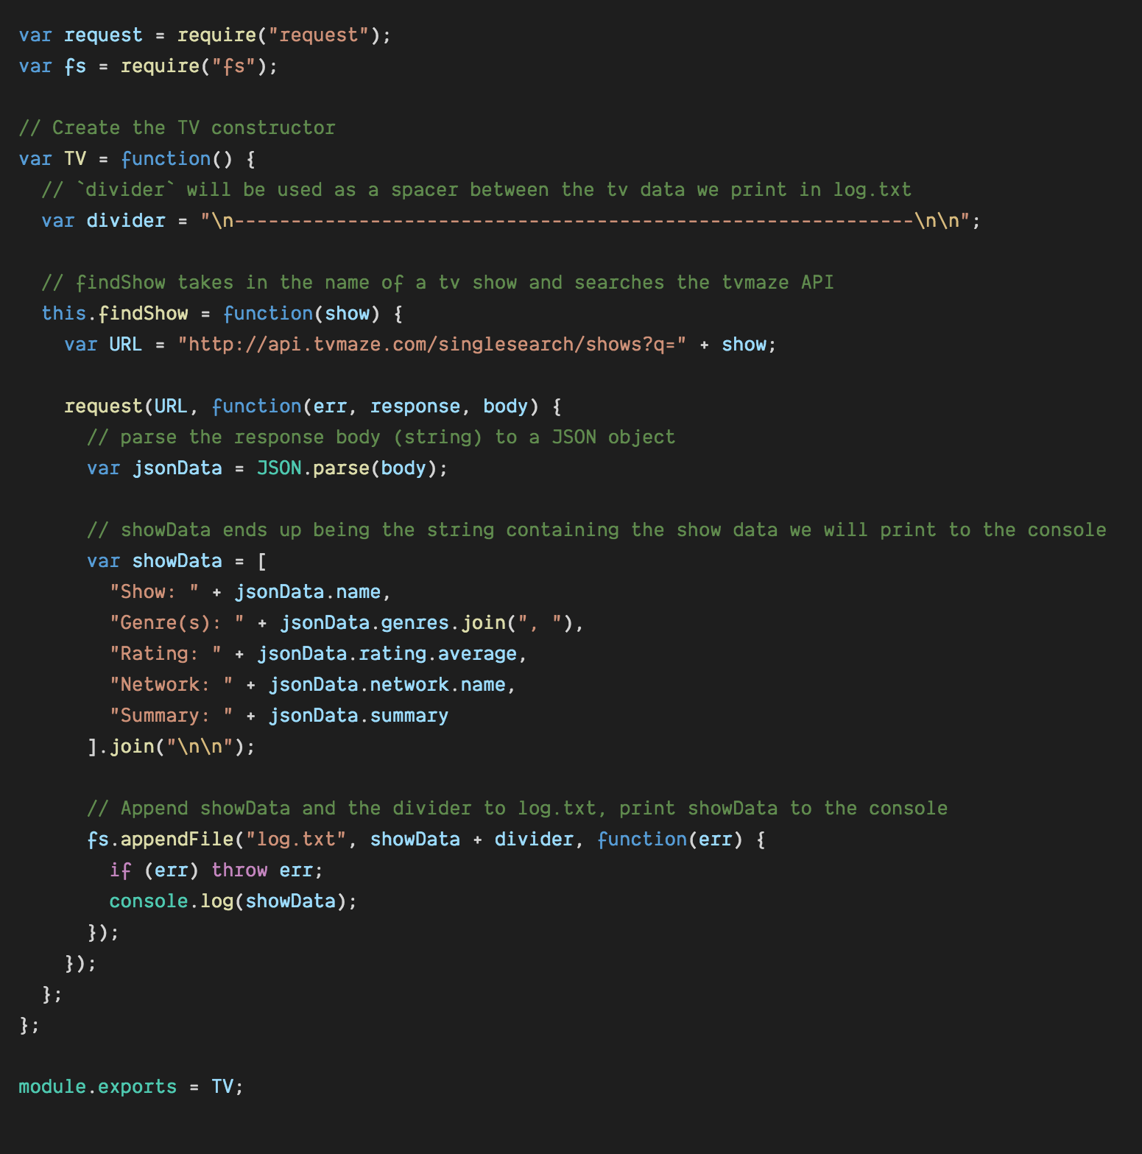
Objectives Met
Use objects to perform AJAX requests, and save data to local files;
Use constructors to create those objects;

Slide 20
7. Instructor Do: Review Activity (7:50 PM - 8:00 PM) (10 mins)
11-js-constructors/01-Activities/13-Stu_FindShow
Emphasize:
We use the axios package to search the TV Maze API, and parse the body as JSON.
showData is just a big multi-line string containing the data we we’ll be using. Using an array of strings we join together can be a more human readable way to achieve this than concatenation.
We use the fs.appendFile method to save this information along with a divider — just a series of dashes — to the log.txt file.
When complete we log the data to the console.
Point out how we call the tv.findShow method in the cli.js file.
Slack out the solution so students can use it as as starting point as they move forward.

Slide 21
8. Partners Do: Implement Find Actor (8:00 PM - 8:25 PM) (25 mins)
Instructions:
tv.js file.
- used to create a TV object capable of searching the TV Maze API for shows and actors.
* Install the axios Package
* After getting the JSON response from the AJAX request, gather…
* Actor Name, Birthday, Gender, Country, URL Summary on Console
* Append to log.txt sole.

Slide 22
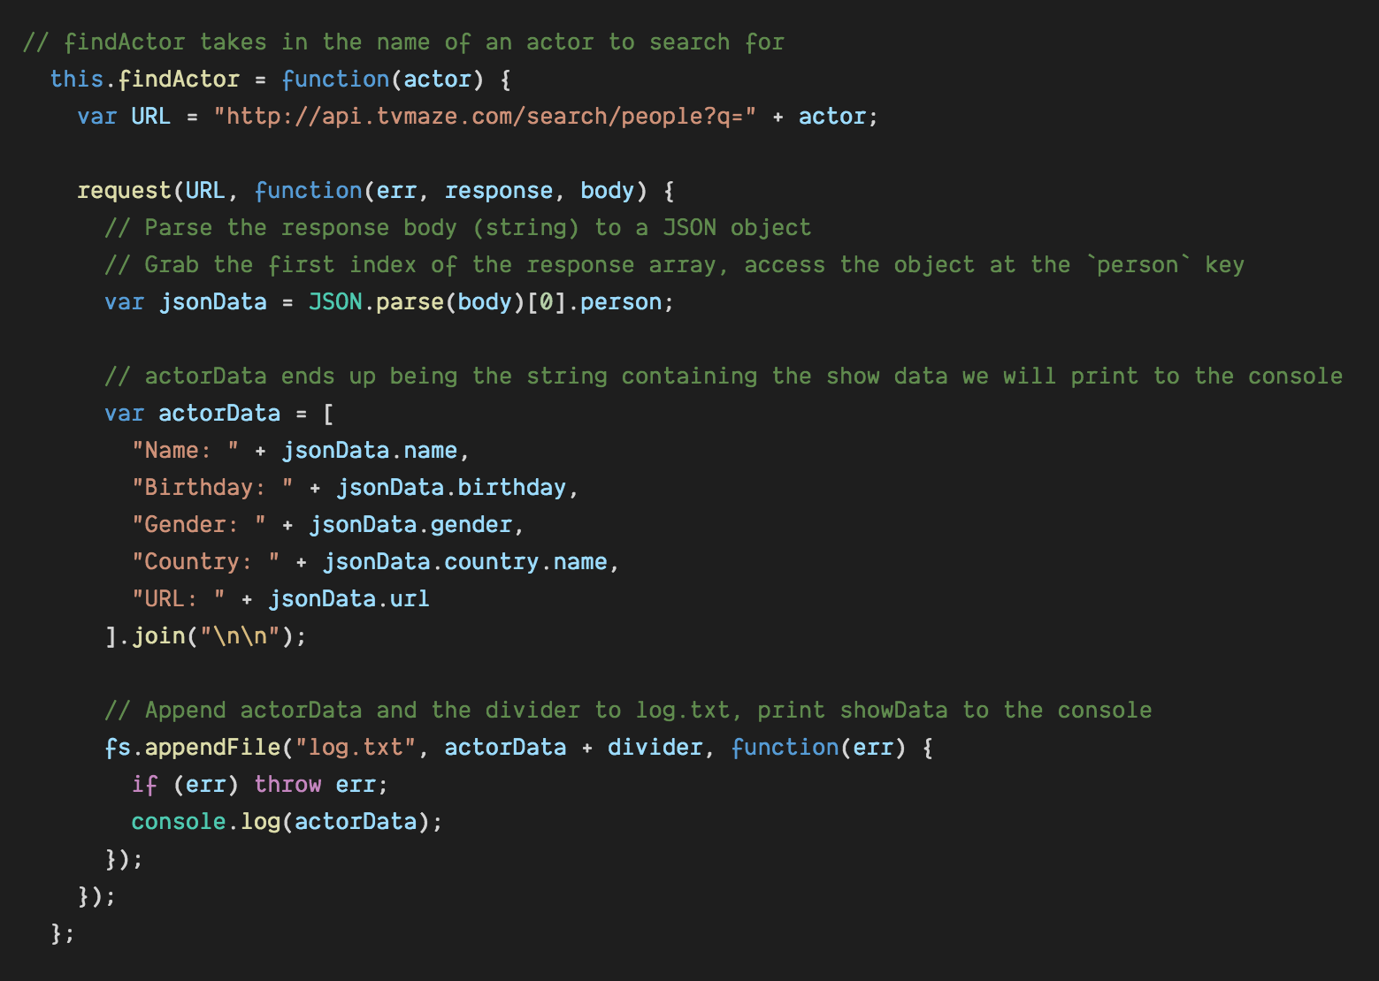
Objectives Met
Use objects to perform AJAX requests, and save data to local files;
Use constructors to create those objects;

Slide 23
9. Instructor Do: Review Activity (8:25 PM - 8:40 PM) (15 mins)
Open up the tv.js inside 14-Stu_FinalTVApp/Basic/Solved file, and walk through the solution.
Find Actor
Point out how the code here is very similar to the findShow method.
This API endpoint returns an array of actor objects, for our purposes we only want the first result, so we grab the 0th index.
Answer any remaining questions and slack out the solution.

Slide 24
10. Everyone Do: Application Review (8:40 PM - 8:50 PM) (10 mins)
Demonstrate the completed application, and have students follow along.
Foster discussion around the benefits of planning an architecture before writing any code.
Also discuss any possible improvements. What else could we add to this application?
Check out the TV Maze API Documentation Site. Point out that we can also search for TV crew or seasons.
Highlight the fact that we’re very close to creating what could be a useful NPM package someone else may want to use.
Take this time to address any outstanding questions students may have.

Slide 25
12. Instructor Do: Callbacks (8:50 PM – 9:05 PM) (15 mins)
Remind students that we can assign functions as values to variables.
Explain that, since functions are values, we can pass them as arguments to functions.
Point out that we’ve used callbacks extensively with jQuery — every time we use event listeners, as well as with the fs package — when we write a function to handle what happens after data is read, written, appended, etc.
Explain that functions passed as arguments to other functions are called callbacks.
Explain that this is because we typically intend for the function receiving the callback to do some work, and then call back the function we pass with its results.
Explain what happens when we call fs.appendFile:
First, fs.appendFile adds the text we pass in to the file that we specify.
Then, one of two things happens. Either:
fs.appendFile hits an error writing to the file. In this case, it calls the function we’ve given it with an error argument.
fs.appendFile writes the data we want. In this case, _it calls the function we’ve given it and does not pass it an error.
In either case, the fs.appendFile function does some work, and then calls us back when complete so we can do something afterwards.
Explain that callbacks are one way for us to handle what happens right after some asynchronous code completes.

Slide 26
13. Students Do: Callbacks Activity (9:05 PM - 9:20 PM) (15 mins)
Slack out the following instructions.
Instructions:
Write a function that accepts a string and a function as arguments. It should log the string, and then run the function.
Write a function that accepts a boolean value and a function as arguments. It should run the function if and only if the boolean argument is true.
Write a function that accepts a function(F) and a value (V), and returns a function that returns the result of running F on V. This sounds tricky, but it’s easier than it sounds—just take it step by step!
Finally, write a short message to a file using fs.writeFile. Does this function use callbacks? If so, identify them.

Slide 27
14. Instructor Do: Review Activity (9:20 PM - 9:30 PM) (10 mins)
Open up callbacks.js in 15-Callbacks/Solved, and step through the solution.
Pay special attention to:
Explaining that, in each example, func is a value that contains a function. This is why we can put parentheses after it—this calls the function.
Explaining that, when we pass a function a callback, we can do other work before we call the callback. This allows us to reuse functions we already have, but decorate them but doing “extra stuff”.
Briefly explain the notion of function decoration.
Emphasize that students have been using callbacks from the beginning of their JavaScript studies. Today’s lesson simply associates the concept with a name.
Slack out the solutions and take a few moments to answer outstanding questions.

